Slide 1
USER TALENT SEGMENTATION
ÇİYA BARAN ÖNER

Slide 2
TABLE OF CONTENTS
INTRODUCTION AND PROJECT OBJECTIVE
PROJECT DESCRIPTION, PROJECT OBJECTIVE
DATA ANALYSIS
MODELLING APPROACH
PLAYER SEGMENTATION WITH CLUSTERING ALGORITHM
MODEL TRAINING
ADAPTATION CHECK AFTER 100 LEVELS (LOGISTIC REGRESSION AND ANOVA TEST)
RESULTS AND CONCLUSIONS

Slide 3
INTRODUCTION AND PROJECT OBJECTIVE
Project Description: This project analyzes users' data before Level 100, clusters them, and effectively segments users based on their skill levels after Level 100.
Project Objective: The aim is to group users based on their performance and behavior before Level 100 and to evaluate group stability after Level 100.

Slide 4
DATA ANALYSIS – Data Exploration
This stage involves data exploration. It helps identify the relationships between metrics, difficulty differences between levels, relationships between datasets, and the features required for our model.

Slide 5

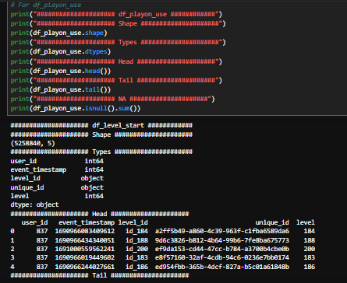
- Selection and loading of datasets that will be useful for grouping users.
- Preliminary examination of each dataframe.
- This includes steps such as learning the data types, examining the number of data points, reviewing the columns in the data, and checking for null values.

Slide 6

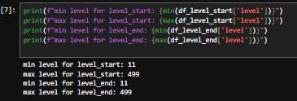
- Determining the number of players before and after Level 100. Since some players only have data after Level 100, these players will be excluded to ensure the reliability of the analysis.
- Finding the minimum and maximum levels is important for data exploration. For instance, discovering later that the minimum level is 11 could raise suspicions of an error.

Slide 7
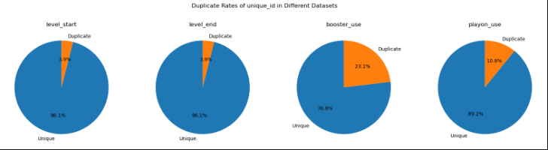
Identifying the relationship between playon_use, level_start, and level_end, and including playon_use as a metric.
Playon_use information is directly related to the player's skill. It is important to utilize this metric.
It was discovered that unique_id is unique for each gameplay moment. Repeats in this metric allowed the inclusion of the playon_use metric. Below, the repeat rate of unique_id is visualized for each dataframe.

Slide 8
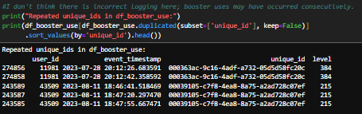
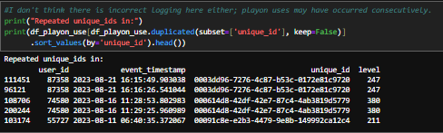
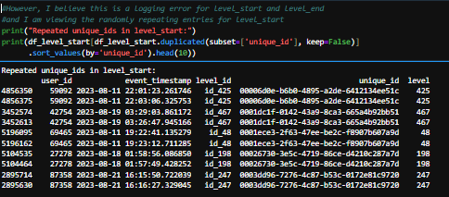
df_booster_use review:
- No erroneous record is suspected here; booster usages may have occurred consecutively within the same gameplay session.
df_playon_use review:
- No erroneous record is suspected here either; playon usages may have occurred consecutively within the same gameplay session.
Repeats of unique_id in level_start:
- Initially, this situation was thought to be a logging error for level_start and level_end, as it appeared to be unusual. The possibility of a logging issue for level_start and level_end was considered.

Slide 9
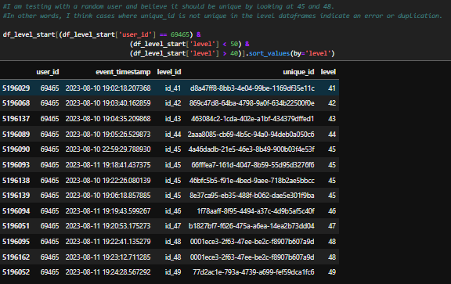
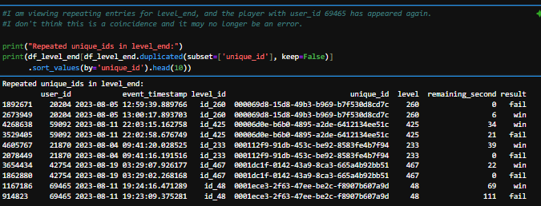
Detailed review for level_start:
The player was chosen randomly.
Level filtering was done to cover 45 levels that were thought to be incorrect.
Then the player's level activities were examined.
Cases where unique_id was not unique in level data frames were still thought to indicate an error.
Detailed review for Level_end:
Repeated entries for level_end were examined.
The previously selected user_id player with 69465 has reappeared.
After this situation, it was thought that the repetitions might not be errors, but were processed logically.

Slide 10
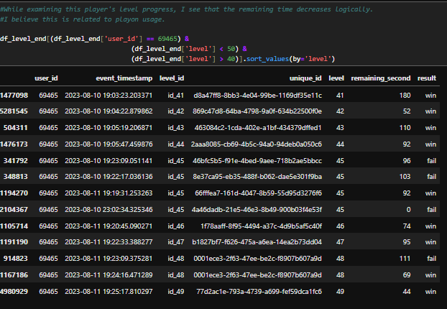
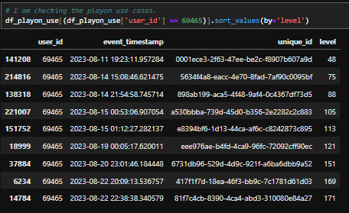
Examination of the level_end progress of the player concerned:
The level_end records of the same user were examined at a level range that was unique_id repetitive.
It was thought that this situation could be related to playon_use.
Examination of playon_use records of the same user:
To be sure, the player's playon_use records were examined for the last time, and again a level range was determined for review.

Slide 11
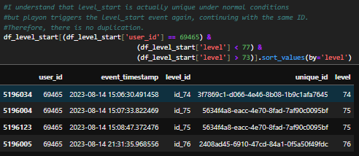
Examining the level_start for the last time to finalize the relationship:
Level_start was known to be unique under normal circumstances.
However, since the game continues with the same unique_id after playon_use, it triggers the seviye_başlang ic event again. Therefore, duplication is out of the question.
RESULT:
It was decided that these values would be added as features in the feature engineering section.

Slide 12
DATA ANALYSIS – Data Visualization
This section includes an understanding of game difficulty and an examination of some key metrics for before and after 100 levels.

Slide 13
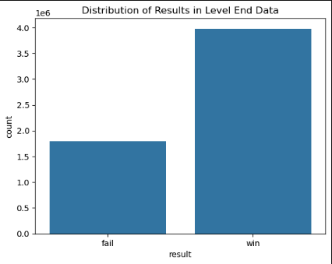
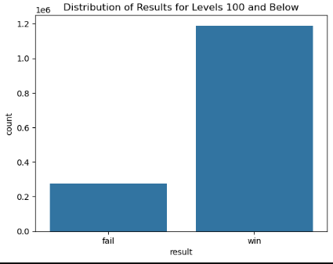
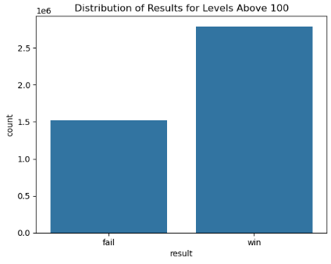
1. Fail and win numbers in the data containing all the data
2. Fail and win numbers for data at level 100 and above
3. Fail and win counts after 100 levels
CONCLUSION: The graphics show that the game is more challenging after 100 levels. In other words, the success rates of the players that we will group with data before 100 levels will most likely decrease.

Slide 14
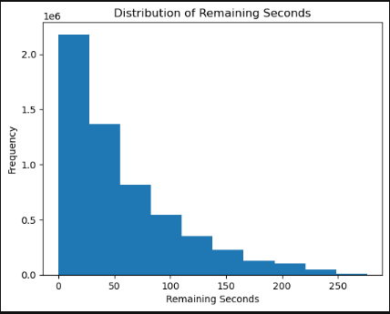
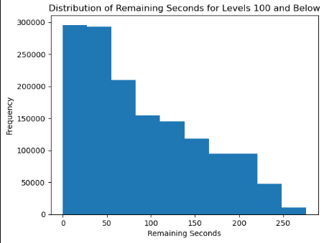
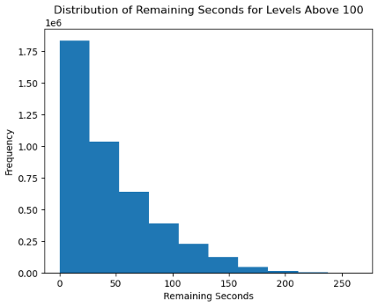
1. Histogram chart of time remaining in the data containing all the data.
2. Histogram chart of time remaining for 100 level and before.
3. Histogram chart of the remaining time after 100 levels.
CONCLUSION: Again, the graphics show that the game is more challenging after 100 levels. In the chart, it is seen that there are piles after 100 levels. Charting these key metrics; It presented the main differences for before and after 100 levels.

Slide 15
DATA ANALYSIS – Data Manipulation
This stage includes the separation of unnecessary data in data sets and the removal of distorted metrics.
At this stage, it also includes creating new metrics, merging data sets, and data transformations.
Handling missing data and quantifying categorical variables are also included in this stage.

Slide 16

Removal of the Level_id Column
- It has been determined that the level_id column in the level_start and level_end data sets does not coincide with the level column.
- Mismatched data records have been deleted. Level information will be taken from the «level» column.

Slide 17
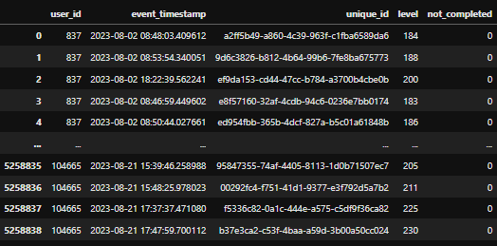
Adding the Not_completed Column
- The existence of game moments that are recorded in the Level_start but not recorded in the level_end dataset has been detected. This metric will be useful in identifying players who leave without completing the game.
This was added with the name not_completed.
0: level completed 1: Level not completed

Slide 18
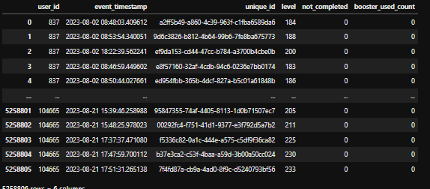
Merging Booster_use data with level_start
- Merge operations will generally be continued by adding to the df_level dataframe over the df_level_start dataframe, and the merged_df, which is the last dataframe, will be created over the df_level.
Consolidation operations are carried out on a level_start basis; It is to prevent the loss of metrics at incomplete levels.
- The purpose of creating df_level intermediate dataframe is to prevent the original df_level_start, df_level_end dataframes from being corrupted.

Slide 19
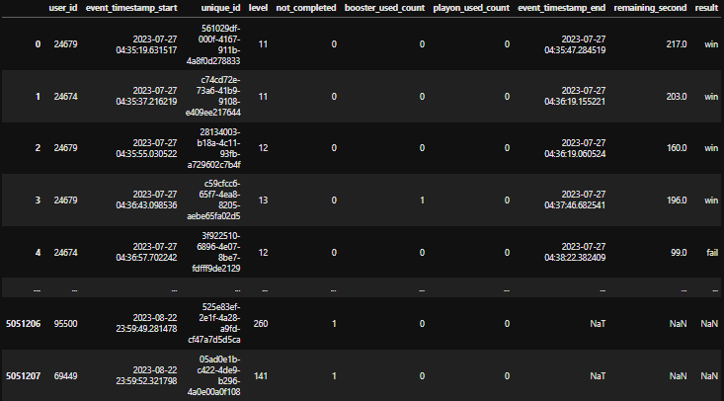
Calculating playon_use and Merging Datasets
- Since we also need df_level_end to calculate the playon_use information, all data sets are united on merged_level_df at the end of this process.

Slide 20
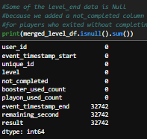

Removing of Missing Data and Optimization of Data Types
- In this dataframe, there are Null data in the df_level_end columns. This is due to players exiting without completing the game.
event_timestamp_end: It is filled with 0 in order to avoid null data, it will not be a metric that we will use anyway.
result: Null data in this metric is treated as a failure because the player has given up.
- remaining_second: Instead of the Null data found in this metric, it is populated with each user's own average value.

Slide 21
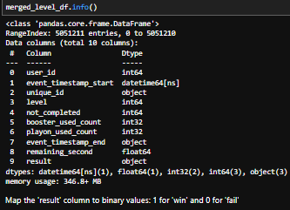
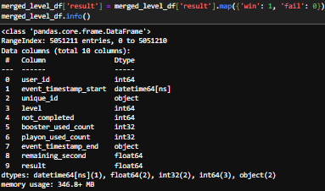
Digitization of the Result Value
The Null data generated after the merge was successfully populated.
- After these processes, it is necessary to examine the data types of the columns of the merged_level_df dataframe. Necessary changes should be made to comply with the model.
- Win and fail result values have been converted to numeric values.
1: win
0: fail

Slide 22
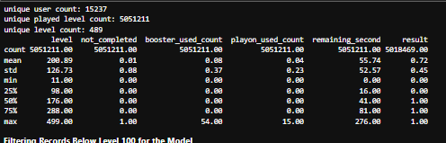
Statistical Review of Metrics
- The statistical analysis of the columns in merged_level_df dataframe that we combined and obtained with all the metrics is as follows:
- The purpose of this analysis is to examine whether there are any incompatibilities/errors in the data. As a result of the examinations, no mistake was detected. In the next step, the data will be parsed to cover 100 levels and before, then summary information of the players will be created for clustering.

Slide 23
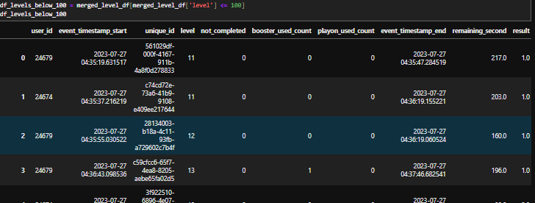
Separation of 100 Level and Earlier Data
- Clustering will be done with 100 level and before data. df_levels_below_100 dataframe has been created.

Slide 24
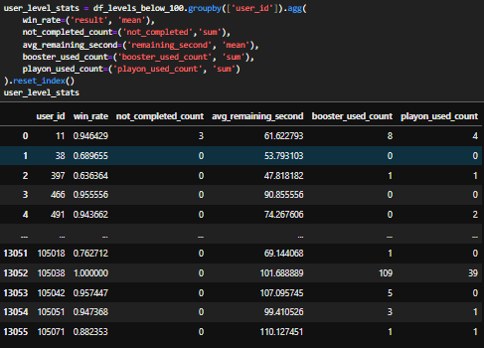
Creation of Summary Information of Users
win_rate: It is the average of the users' results. It is used in talent classification.
not_completed_count: This metric is calculated based on the number of non-completions calculated with sum. It allows us to find users who have given up.
avg_remaining_second: This metric represents the average number of seconds users finish with left. It is effective in determining the level of ability.
booster_used_count and playon_used_count: These metrics show users who are struggling in the game and are also effective in identifying players who are inclined to spend.

Slide 25
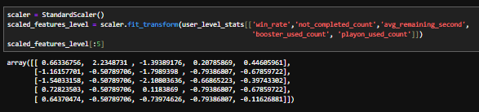
Data Standardization
- Data has been standardized with StandardScaler for better operation of clustering algorithms.

Slide 26
MODELING APPROACH
At this stage, with 100 level and earlier data, players were grouped according to their skill level and spending status.
3 different clustering algorithms were compared and K-Means was selected as a result.
After the players are grouped, group information is added to each player.
Finally, the compatibility between the group knowledge and the behavior of the players who were divided into groups with the data at 100 levels and before was confirmed by Logistic Regression and statistical approaches.

Slide 27
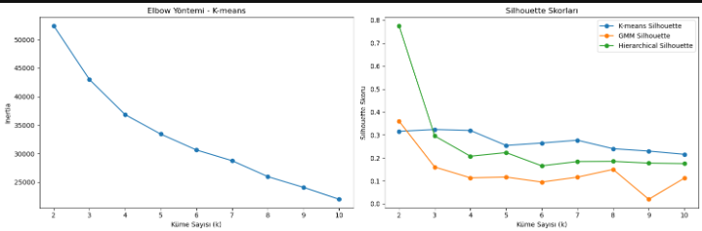
Determining the Number of Clusters
- The range of the number of clusters is determined as (2-11). Silhouette Scores (used for all algorithms) and the Elbow Method Approximation for K-Means were then calculated to see at which number of clusters the clustering algorithms performed best. After the graph values, it was decided as N = 3.

Slide 28
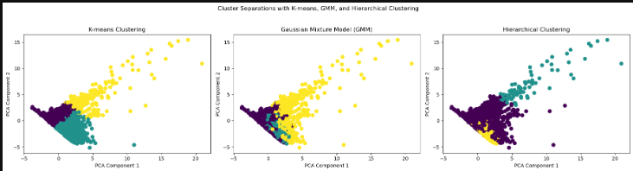
Determining the Clustering Algorithm
- The algorithm with the best divergence is determined as K-Means.

Slide 29

Calculating the K-Means Silhouette Score
- Clustering results with a Silhoutte Score above 0.5 are considered good. However, values between 0.3-0.5 are considered sufficient for clustering. In other words, although there are not very sharp clusters, it is seen as a satisfactory result.

Slide 30
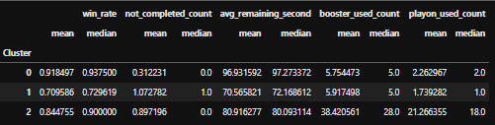
Analysis of Player Groups
Cluster 0: Skilled and Fast Players
High win rate; These players complete the levels with great success. With a low abandonment rate, talls almost never leave the level. At the same time, they finish the levels quickly. They very rarely need extra help in-game.
Cluster 1: Players Who Are Challenged and Give Up
Low win rate; These players have a hard time passing the levels. These players with a high abandonment number exit more often without completing the levels. They use the bulk of the time when beating levels, so they are not fast players. They use moderate auxiliary elements, they need help, but they do not use auxiliary elements.
Cluster 2: Medium Skill and Frequent Assist Players
Medium win rate; The success rate is moderate. Players in this segment leave some levels uncompleted, but not as often as Cluster 1. They usually spend an average amount of time completing levels. Players in this segment frequently use support items, they have a lot of in-game investments.

Slide 31
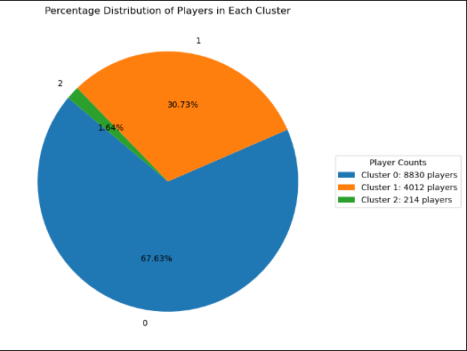
Number and Distribution of Player Groups
The distribution of players is as shown in the graph.

Slide 32
Recommendations for Segments
Cluster 0: Skilled and Fast Players
-These players are skilled and have a good command of the game mechanics. In order to increase the likelihood of this segment of players staying in the game longer and spending in-game;
-These players may be presented with more difficult tasks as they progress to make the levels more engaging. In particular, levels that require speed and skill can be designed or touted as such.
-Talented players are motivated by leaderboards and rankings that encourage competition. A competitive environment can be offered, especially with weekly or monthly events.
-Depending on their achievements, they may be offered extra rewards, badges, or special in-game perks. This makes players feel special.

Slide 33
Recommendations for Segments
Cluster 1: Players Who Are Challenged and Give Up
-This segment often leaves without completing the levels because they find the game difficult. Various ways should be tried to improve the gaming experience of these players, prevent them from disconnecting from the game, and encourage their spending.
-These players may be offered in-game hints or extra chances to try if they fail. Promotions that encourage the use of auxiliary elements can be made, especially at levels with a low success rate.
-Early in the game, you can set simpler tasks or shorter objectives for these players. By increasing the difficulty level step by step, the player can be helped to gain confidence.
- You can offer a tutorial section or hint system as a guide on what these players are struggling with. Thus, you can give them a better understanding of the game mechanics.

Slide 34
Recommendations for Segments
Cluster 2: Medium Skill and Frequent Assist Players
-This segment is a group that tends to invest in the game and frequently uses support elements. They also have an average success rate.
-Offering extra perks or special offers to these players can increase their in-game spending.
-Special discounted packages or bonus support items may be offered for these players. They may show interest in such packages because they use help frequently.
-These players may be offered a VIP membership or premium content that will offer exclusive benefits. They may be interested in special privileges because they are prone to spending more.

Slide 35
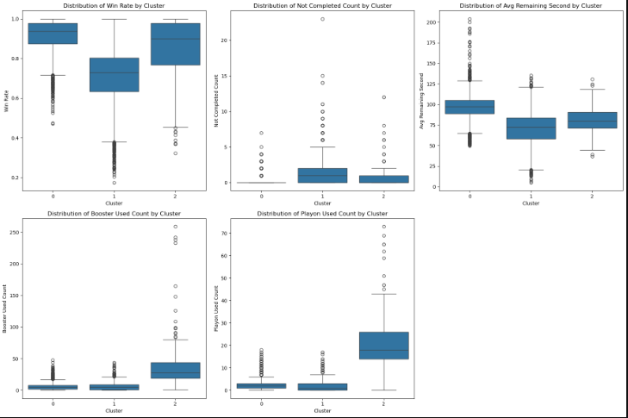
Visualization of Metric Values of Segments
The values on the chart have already been examined and commented on.

Slide 36
Verification with After 100 Level
At this stage, the aim is to see if the created segments are meaningful after 100 levels.

Slide 37
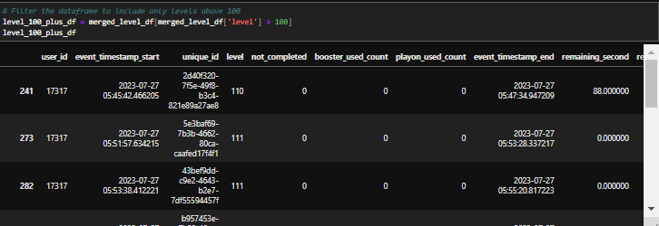
Filtering of post-Level 100 data
The data were disaggregated after 100 levels.

Slide 38
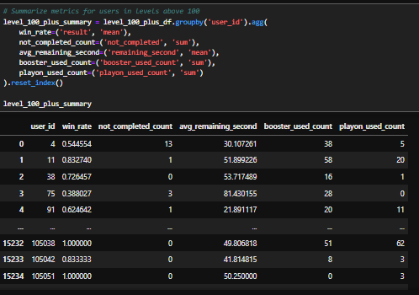
Creating User Summaries for After Level 100
- Summaries of users were created with data after 100 levels. This is necessary to make sense of the connection between the players and their segments.

Slide 39
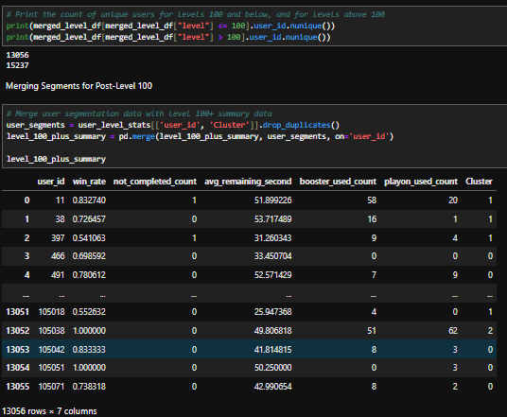
Adding Cluster Information to data after 100 levels
- Cluster information created before 100 levels has been added to users in the data after 100 levels. Null data check was performed.

Slide 40
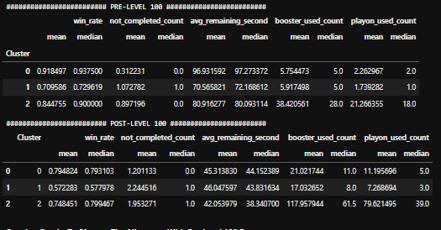
Level 100 and Before vs. Level 100 After
-It is seen that the players generally continue in the same trend.
-The win rate value has decreased for each group, but the grouping is still maintained. We were already thinking from our first analysis that the success rate would decrease.
-The group structure has been maintained in the rate of exiting from completion, but it is seen that the average of talented players has increased.
-In the same way, the remaining time decreased to approximately the same values for each group. Here, it is difficult for players to separate.
-The use of auxiliaries continued to be maintained between groups.
As a result, as a result of the comparison, it shows that the groups generally maintain their behavior after 100 levels.

Slide 41
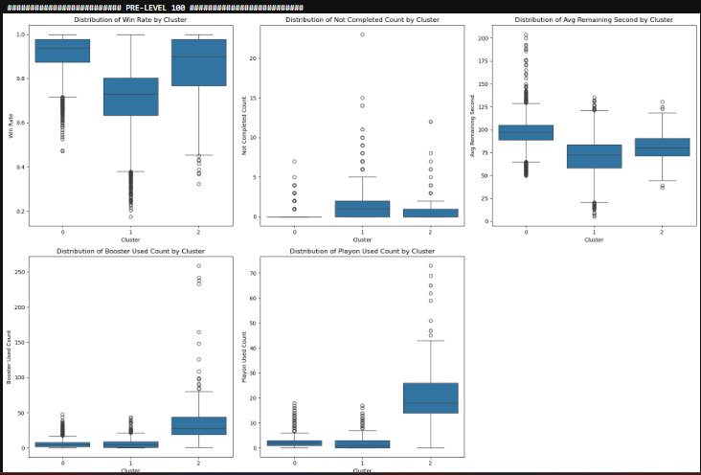
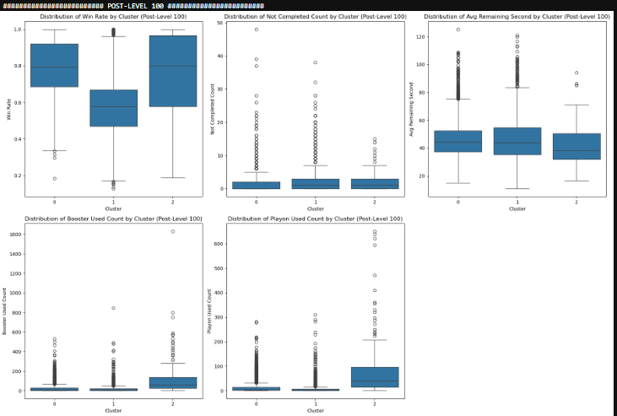
100 Level and Before vs. Level 100 After
As you can see, after 100 levels, the biggest differentiation between skilled and medium-skilled players is the purchase of 'auxiliary items'.

Slide 42
Verification of the Relationship
This step involves the precise verification of the relationship verified with the help of graphs by Logistic Regression and ANOVA Test.

Slide 43
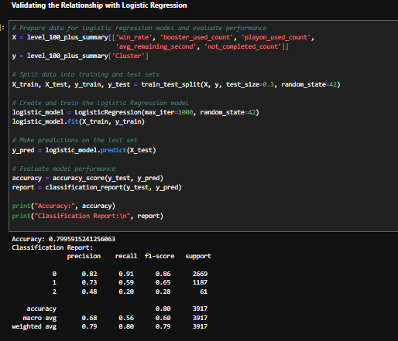
Establishment of Logistic Regression and Success Rate
- Metrics that players have after 100 levels, feature; Segment values at 100 levels and above are assigned as Cluster target variables.
- The purpose of the model is to show that the segments are effective after 100 levels.
- The model is not very successful due to the imbalance between the data. However, the accuracy rate is still substantial. That is, the segments still tend to maintain their structure after 100 levels.
- An ANOVA Test was also performed to confirm the relationship.

Slide 44
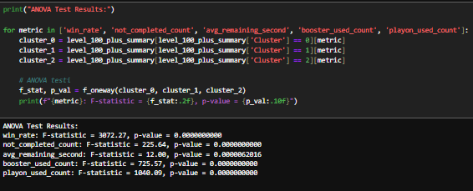
ANOVA TEST AND RESULT
RESULT:
These ANOVA test results strongly suggest statistically significant differences in each metric between segments. It can be said that segments are quite distinct, especially in metrics such as win_rate, booster_used_count, and playon_used_count. This shows that the segmentation process provides a significant divergence in terms of player behavior after Level 100. We can say that segments really represent different levels of player ability, and segmentation achieves its purpose.

